Slide 1


2012 NER Area 2
Membership and Marketing Conference
March 31, 2012
Increasing Venturing Membership
With Focus on Recruiting Young Women
Presented by:
Gina Curtis, National Venturing Vice President
Christine Luczka, NER Venturing President
Bob Koch, NER Area 2 Venturing Advisor

Slide 2
Outline
Purpose of this presentation – Why this topic
Why its critical to Youth Membership Growth
  Untapped market opportunity
Baseline:
  Current Membership Numbers
    National, Regional and Area
Barriers to Female Membership
  Challenges to Recruiting Young Women into Venturing
Tremendous Membership Growth Opportunities
  Best way to attract Young Women into Venturing
  What is it that makes Venturing exciting to Young Women
  Overcoming the challenges
Developing an Action Plan ~ And Follow thru
Available Resources

Slide 3
Purpose
Review the Current Venturing Membership
Raise the awareness of the decline in Venturing Membership
Understand the Opportunity for Growth
Discuss Challenges to Venturing Membership
Focus on an area where councils can immediately grow their Venturing program
Identifying Solutions for Addressing Challenges

Slide 4
And Why This Specific Topic
There is a large market of young women who are looking for leadership opportunities
The Diverse Venturing Program opens itself up to a multitude of interests
Traditional Teenage programs have become less interesting
While somewhat structured, it provides pliability where necessary

Slide 5
Current Young Woman/Young Men Split

Slide 6
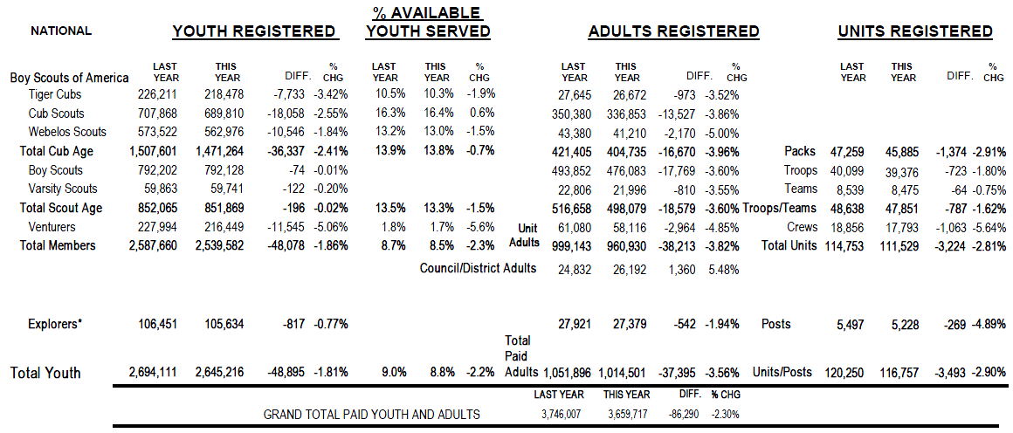
National Membership
As of January 2012

Slide 7

Northeast Region Membership
As of January 2012

Slide 8
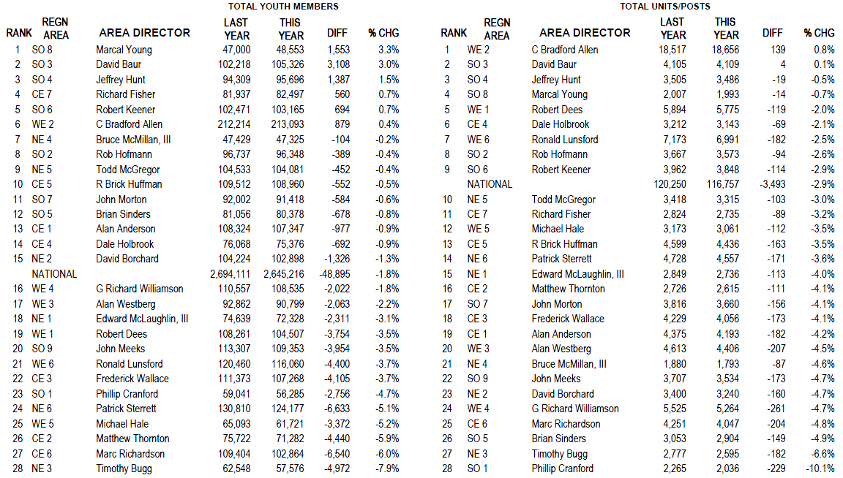
Membership Rankings
As of January 2012

Slide 9
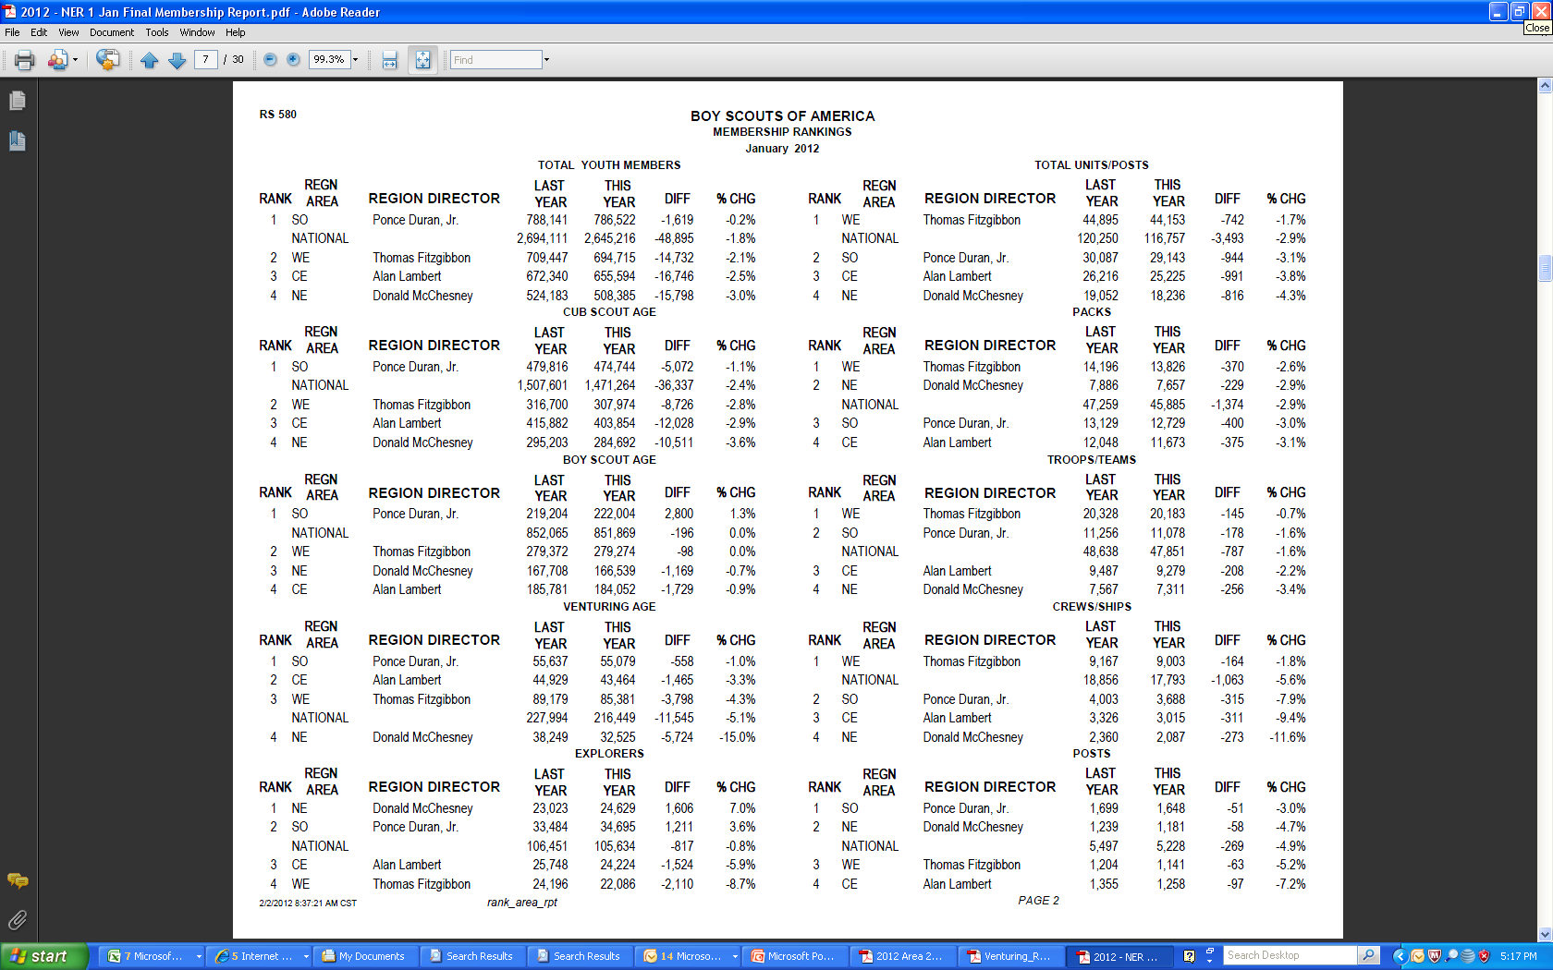
Comparison’s By Region
As of January 2012

Slide 10
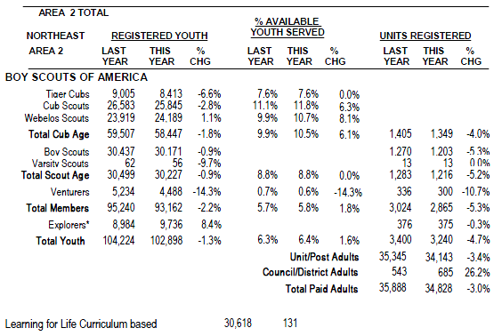
Area 2 Venturing Membership
As of January 2012

Slide 11
Challenges in Joining Venturing
Lack of Awareness
Many Other Activities
Peer Influence
Small Age Window for Membership
Marketing
  Appealing to females in non-scouting families
  Separation between high-school and college youth
Notes:
Lack of Awareness
Lack of knowledge and understanding about the venturing program. Many do not know it even exists.
Many Other Activities
Sports, Clubs, School, Beer, Karate
Peer Influence
More likely to join if friends join, Most of the time people come to their first meeting with a friend.
Scouting isnt ‘cool’ among many
Small Age Window for Membership
13-20
Two completely different groups (highschool vs. college)
Marketing
Appealing to females in non-scouting families
Separation between high-school and college youth

Slide 12
What Makes Venturing Exciting For Girls?
GSUSA
Outdoor Opportunities
    High Adventure
Chance to Take on Youth Leadership Roles
Safe and Constructive Environment to Interact
    Males, Females and Adults
Skills for the Future
    Training Opportunities

Slide 13
Possible Solutions
Lack of Awareness → Peer-to-Peer Recruitment
Many Other Activities → Marketing & Early Recruiting
Peer Influence → Bettering the BSA Brand
Small Age Window for Membership
                → Recruit Early & Retention
Marketing → Specialized
  Appealing to females in non-scouting families
  Separation between high-school and college youth

Slide 14
Specific Council Actions
JTE Requirements
  Council to Include Venturing in their Marketing & Membership Plan
Building a strong Council Venturing Officers’ Association (VOA)
  Look to Area 2 VOA for Support, Guidance, Training
Marketing Venturing Activities
  Crew, Council and Area Events
Setting Goals
  To Track Progress

Slide 15
Summary
There is a decline in Venturing Membership – At all levels
There is a great opportunity the increase growth with a focused direction
While there are many challenges in Venturing Recruitment…
…There are many ways to attack the opportunity
But, not without an aggressive recruitment plan, continual monitoring and building a strong council venturing program

Slide 16
Thank You for Attending this Session

Slide 17
Contact Information
GINA CURTIS
Gina.Curtis@gmail.com
CHRISTINE LUCZKA
Christine_Luczka@yahoo.com
Bob Koch
bobbsa@optonline.net

